Slide 1
ENHANCED ENTITY-RELATIONSHIP (EER) MODEL – 1
Dr. Ejaz Ahmed

Slide 2
- Objectives
Introduction to EER Modeling +
Concepts of the EER Model +
Specialization +
Generalization +
Constraints on Specialization/Generalization (S/G) +
S/G Notation Summary +
Dr. Ejaz Ahmed

Slide 3
- Introduction to EER Model
Since the late 1970 there has been an increase in the emergence of new database applications with more demanding requirements.
Basic concepts of the ER model are not sufficient to represent the requirements of the newer, more complex applications.
To represent these requirements additional ‘semantic’ modeling concepts are needed.
These semantic concepts are incorporated into the original ER model and became Enhanced Entity-Relationship (EER) model.
Additional concepts of EER model include:
  Specialization
  Generalization
  Categorization
EER diagrams are similar to the class diagrams used in the OO model.
Dr. Ejaz Ahmed

Slide 4
- Concepts of EER Model …
The EER model includes all the concepts used in the ER model:
  Entity types
  Attributes
  Relationship types
In addition, the EER model includes the following concepts, which come from the OO model:
  Supreclass/subclass relationships
  Attribute inheritance
  Specialization
  Generalization
  Categorization
Dr. Ejaz Ahmed

Slide 5
… - Concepts of EER Model
Subclass: is an entity type that has a distinct role and is also a member of the superclass.
Superclass: is an entity type that includes distinct subclasses that require to be represented in a data model.
Attribute inheritance: is an entity in a subclass may posses subclass specific attributes, as well as those associated with the superclass.
The relationship between a superclass and any of its subclasses is called the superclass/subclass relationship.
Dr. Ejaz Ahmed

Slide 6
- Specialiazation
A Specialization is the process of defining a set of subclasses of an entity type.
The specialization of an entity type allows us to do the following:
  Define a set of subclasses of an entity type.
  Establish additional attributes with subclasses
  Establish additional relationship types between some subclasses and other entity types or other subclasses.
The figure in the next slide shows an example of a superclass/subclass relationship between the entity type EMPLOYEE and some of its classes.
  In this figure, local attributes are attached to subclasses
  Common attributes are attached to the superclass
  Some relationships between subclasses are shown.
Dr. Ejaz Ahmed

Slide 7
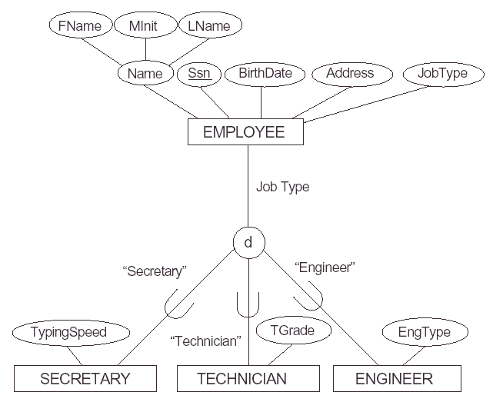
-- Example: Specialization
Dr. Ejaz Ahmed

Slide 8
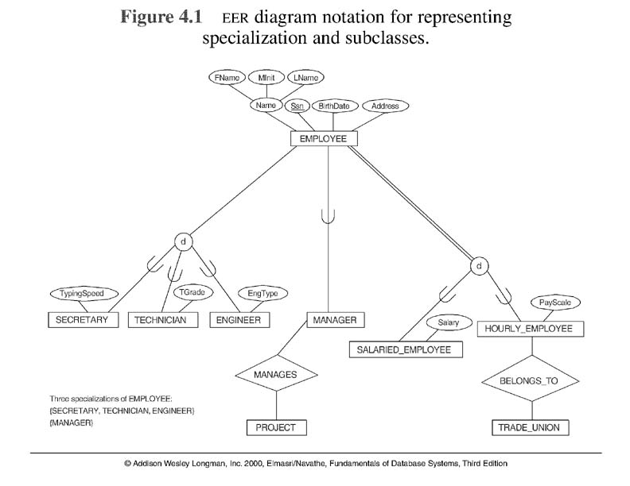
Dr. Ejaz Ahmed

Slide 9
… - Specialization
The following Figure shows an example of some instances of the specialization of the superclass EMPLOYEE into the set of subclasses {SECRETARY, ENGINEER, TECHNICIAN}
EMPLOYEE
e1
SECRETARY
e1
e3
e2
e2
e3
e5
ENGINEER
e4
e7
e5
e6
e4
TECHNICIAN
e7
e6
Dr. Ejaz Ahmed

Slide 10
- Generalization
Generalization is the process of defining a superclass of many entity types.
Generalization can be considered as the reverse of specialization.
  Example: We can view EMPLOYEE as a generalization of SECRETARY, TECHNICIAN, and ENGINEER.
The figure in the next slide shows an example of generalizing the two entity types (subclasses) CAR and TRUCK into the VEHICLE entity type (superclass).
Dr. Ejaz Ahmed

Slide 11
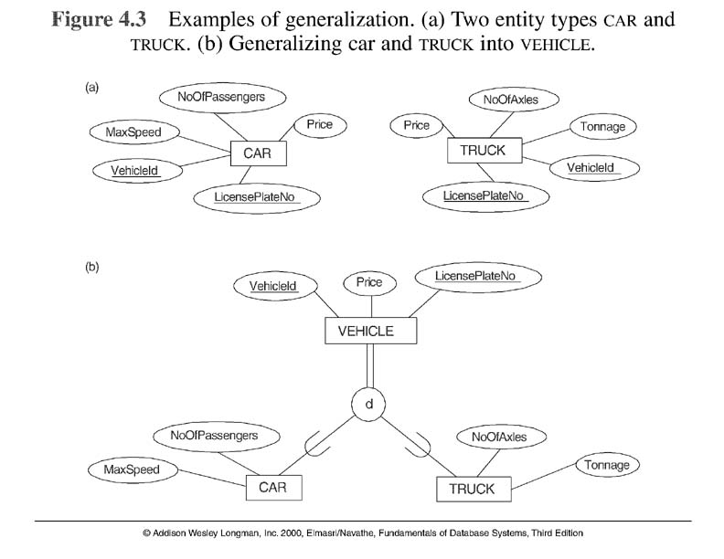
Dr. Ejaz Ahmed

Slide 12
- Constraints on Specialization/Generalization
Attribute defined Specialization +
User defined specialization +
Disjointness constraint +
Completeness constraints +
Dr. Ejaz Ahmed

Slide 13
-- Attribute Defined Specialization
In some specialization we can determine exactly the entities that will become members of each subclass. This is done by placing a condition on the values of some attributes of the superclass. Such subclasses are called predicate-defined or condition-defined subclasses.
If all subclasses in a specialization have the same membership condition on the same attribute, the specialization is called attribute-defined specialization. The attribute is called the defining attribute of the specialization.
In the figure of the next slide we distribute members between subclasses based on the value of the Job Type attribute. Job Type is called the defining-predicate of the subclass.
Dr. Ejaz Ahmed

Slide 14
--- Subclasses based on Job Type Attribute
Dr. Ejaz Ahmed

Slide 15
-- User defined specialization
When we do not have a condition for determining membership in a subclass then we call this specialization a user defined specialization.
Membership is specified individually for each entity by the user, not by any condition that may be evaluated automatically.
Dr. Ejaz Ahmed

Slide 16
-- Disjointness constraint
Look to the superclass/subclass relationship shown in this figure. We can see that the subclasses are disjoint, i.e. every employee entity will belong to only one of the subclasses, SECRETARY or TECHNICIAN or ENGINEER.
This is represented in this diagram by the symbol d which stands for disjoint.
However, there are some superclasses that can be specialized into subclasses that may overlap as the example shown the following figure. Here a PART entity can belong to one or more of the entities MANUFACTURED or PURCHASED.
This is represented in the diagram by the symbol O which stands for overlapping.
Dr. Ejaz Ahmed

Slide 17
… - Overlapping Subclasses …
p1
p1
p2
p3
p5
MANUFACTURED_PART
p3
p7
PART
p4
p5
p2
p6
p4
PURCHASED_PART
p7
p5
p6
Dr. Ejaz Ahmed

Slide 18
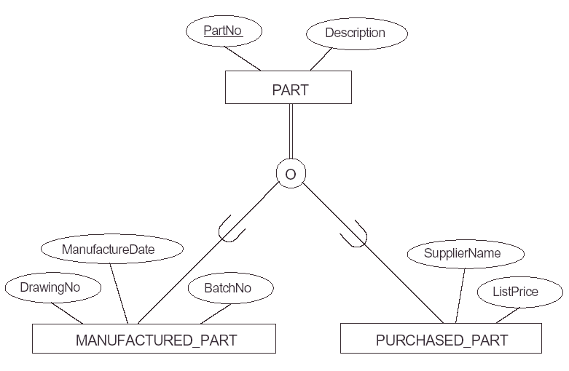
--- Overlapping subclasses
Dr. Ejaz Ahmed

Slide 19
-- Completeness constraints
A total specialization constraint specifies that every entity in the superclass must be a member of some subclass.
For example, if every employee must be either SALARIED_EMPLOYEE or HOURLY_EMPLOYEE then the specialization {SALARIED_EMPLOYE, HOURLY_EMPLOYEE} is total specalization.
This constraint is shown in the figure which is in the next slide by using double lines to connect the superclass as shown in the figure.
Dr. Ejaz Ahmed

Slide 20
--- Example of Total Specialization
EMPLOYEE
Total specialization
d
Salary
PayScale
SALARIED_EMPLOYEE
HOURLY_EMPLOYEE
Dr. Ejaz Ahmed

Slide 21
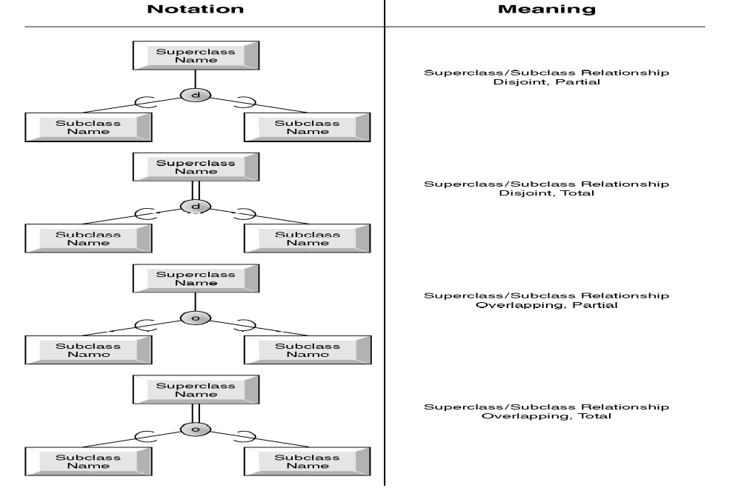
- S/G Notation Summary
Dr. Ejaz Ahmed

